Slide 1

Lending club case study
Group Members:
Chirag Navadia
Ashutosh Dobhal

Slide 2
Problem Statement
Context- When the company receives a loan application , the company has to make decision for a loan approval based on applicant’s profile
If the applicant is likely to repay the loan, then not approving the loan results in a loss of business to the company
If the applicant is not likely to repay the loan, i.e. he/she is likely to default, then approving the loan may lead to a financial loss for the company
Solution -With the use of EDA(Exploratory Data Analysis):
Identify the driving factors towards loan default and use them for portfolio and risk assessment.
Identify the risky loan applicants so that loans can be denied for those applications thereby cutting down the amount of credit loss.

Slide 3
Case study Approach
Data understand and cleaning
Get an idea of the columns and their description and clean the data .
Data Analysis
Identify important variables which are responsible for applications defaulting the loan.
Recommendations
Help reducing the credit loss by not providing loans to the risky loan applicants by working on the variables identified.

Slide 4
Step by Step process
Data Understanding- Going through the columns and data dictionary to make understanding of the data variables.
Univariate Analysis- Analyze the distribution of variables (loan amount, purpose, Lending club’s grade, term, public records) across the default rate.
Bivariate Analysis – Analyze the distribution of 2 variables (loan purpose and amount, loan purpose and grade, loan purpose and debt to income ration and others) across the default rate.
Final recommendations- Summarize the analysis done and provide important points to Lending club which can be used in deciding the outcome of loan application
Data cleaning – Checking the null value percentage across rows and columns to remove unnecessary columns and respective rows. Removing the columns that are irrelevant to our analysis.

Slide 5
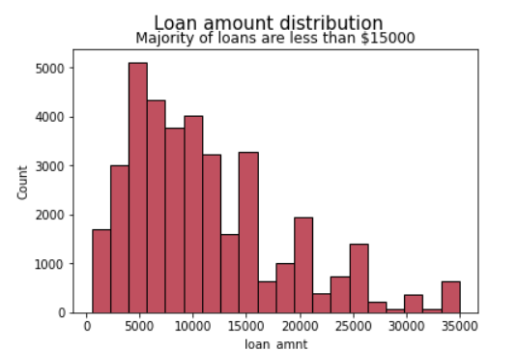
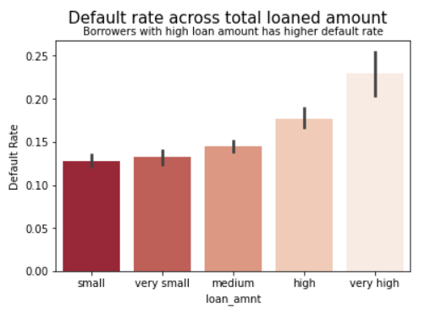
Univariate Analysis
Most of the loan applied were less then $15000 on which the analysis were done.
The higher the loan amount the higher probability of defaulting the loan.

Slide 6
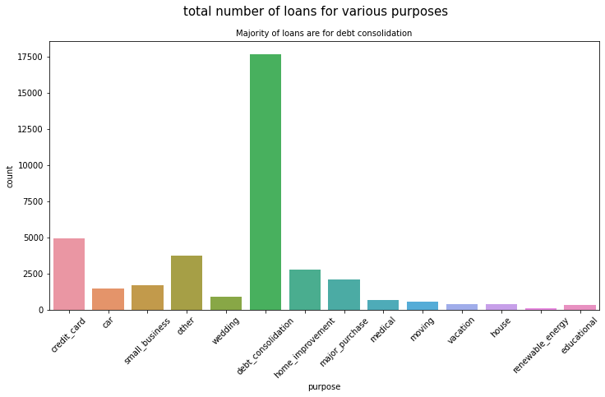
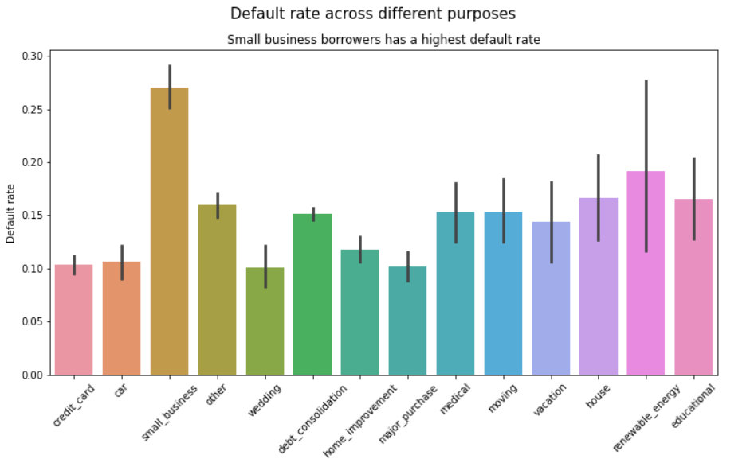
Univariate Analysis
1st slide shows the majority of loans applied are for debt consolidation
2nd slide provides an essential point in deciding the outcome of loan application. It seems that the loan applied for small business tends to have higher default rate.

Slide 7
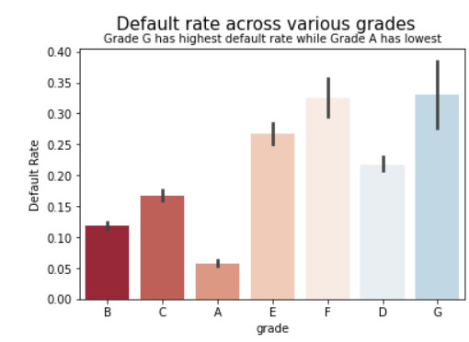
Univariate Analysis
High Quality loans have lower tendency of defaulting the loan.
On the other hand, the lower quality loans have higher tendency to default the loan.

Slide 8
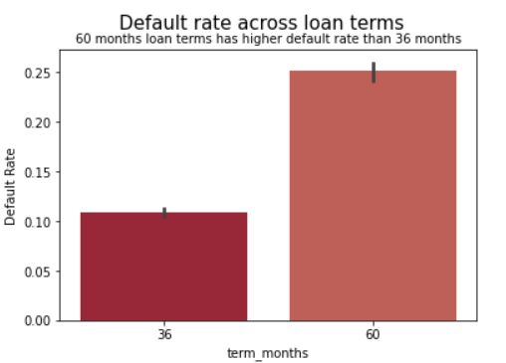
Univariate Analysis
There are only 2 loan terms. Most of the borrowers paid off the loan when loan term in 36 months.
The 60 months loan terms tend to have higher default rate.

Slide 9
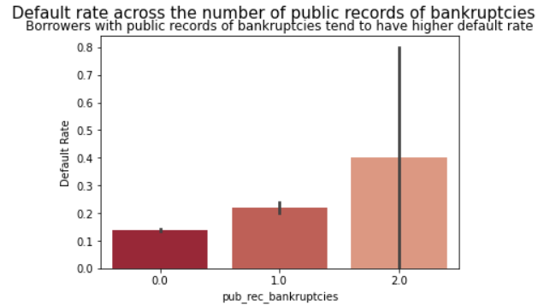
Univariate Analysis
One of the major point which can decide the outcome of loan application is the public record of bankruptcies. The borrowers with higher public records of bankruptcies have higher tendency of defaulting the loan.

Slide 10
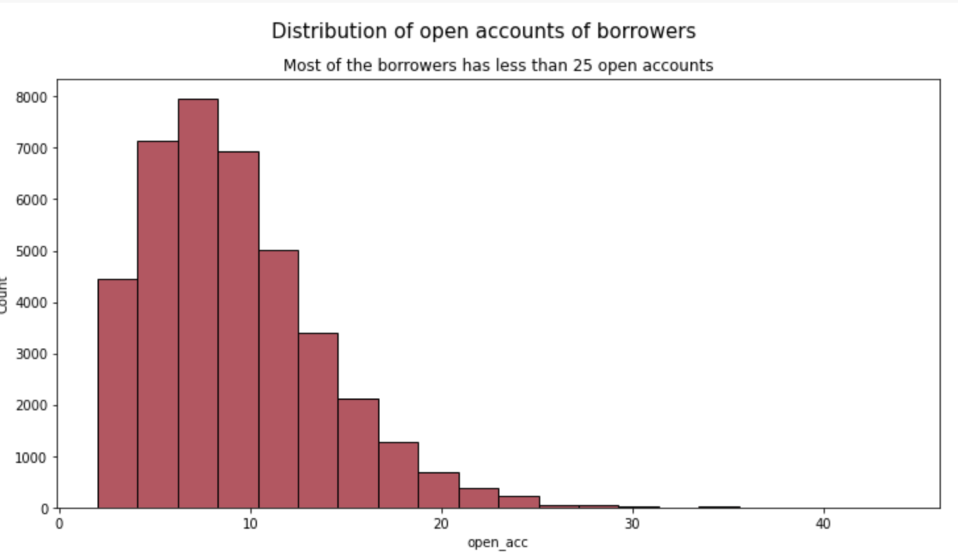
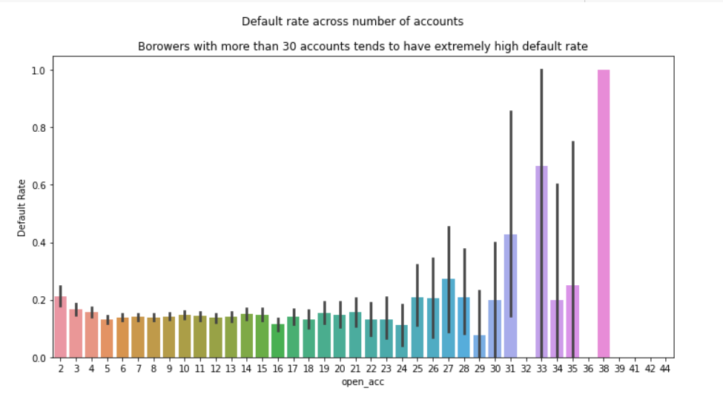
Univariate Analysis
Another major outcome which came was the number of open credit lines in the borrower’s credit file.
It is believed that the large number of open account tend to have higher default rate. However, our analysis did not show significant differences. There is not enough data to conclude that borrowers with more than 30 accounts tend to have higher default rate.

Slide 11
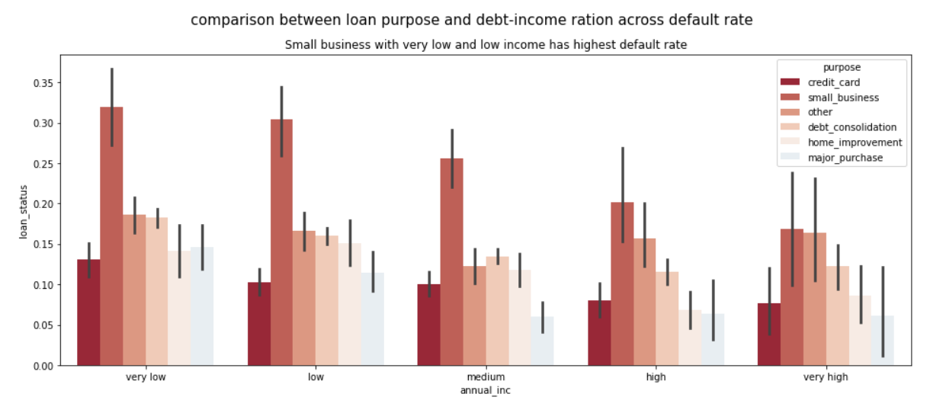
Bivariate analysis
Here we compared 2 variables ‘Loan purpose’ and ‘Debt-income ratio’ across default rate.
Small business with very low income have highest default rate

Slide 12
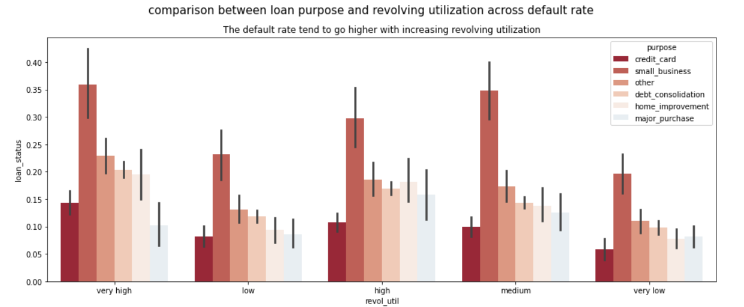
Bivariate analysis
When comparing the ‘purpose’ and ‘revol_util’ across default rate it comes out the default rate tend to go higher with increasing utilization.

Slide 13
Conclusion.
Applications with ‘Higher amounts’ loans (> $15000) should be thoroughly reviewed.
Applications with purpose of loans as 'debt consolidation’ should be closely looked before approving their loan application.
Lending club should stop approving loans for ‘Small businesses’ as there are good number of defaulters with small businesses.
While providing loans for term 60 months the club should do a good background check of the applicants.
Public record should be checked for borrowers with higher public record of bankruptcies as they have higher tendency of defaulting the loan.
It is believed that the large number of open account tend to have higher default rate. However, our analysis did not show significant differences. There is not enough data to conclude that borrowers with more than 30 accounts tend to have higher default rate.
Low grade loans have high tendency to default. Lending club should examine more information from borrowers before issuing loans to Low grade (G to A).
Loans having higher interest rate have more defaulters. Check the background of applicant thoroughly before calculating interest rates.

